Slide 1
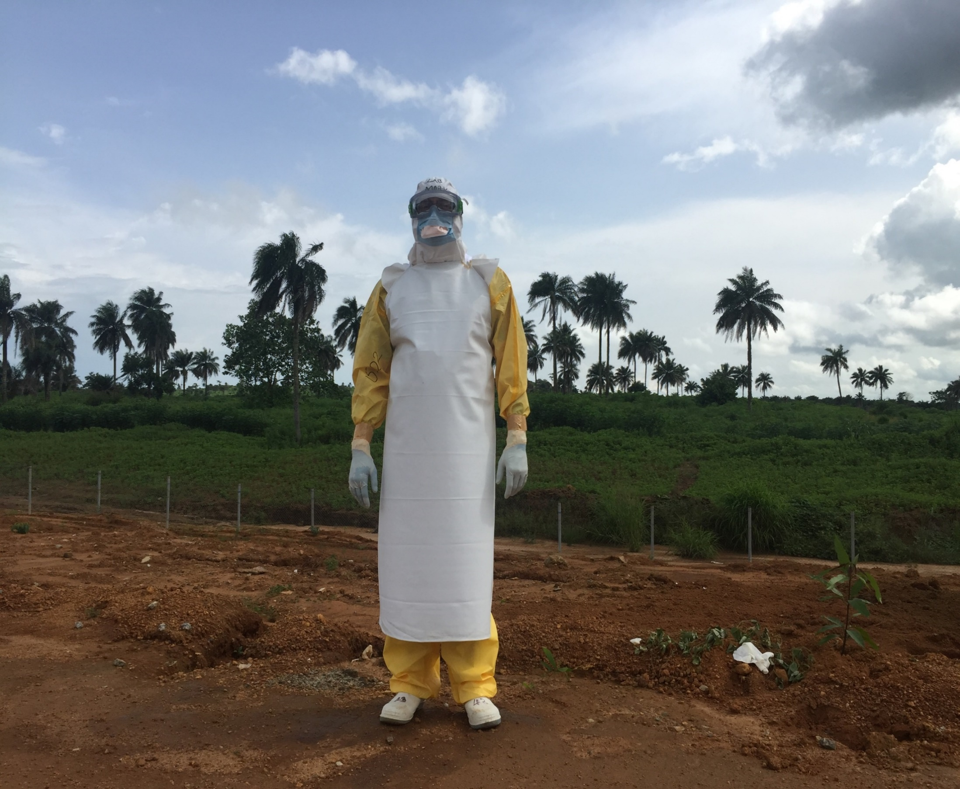
5 weeks in Sierra Leone- Stories from an Ebola Treatment Centre
Presented by Mark Fife
Woodborough School 11th Feb 2016

